Slide 1
Data Review Tool (DRT) Extract in Genie
April 2018

Slide 2
Training Contents
Background
Types of Data Quality Checks
Accessing the Tool
Availability of Data
Structure of the Tool
Additional Resources

Slide 3
Learning Objectives
Understand how the Data Review Tool (DRT) can be used to help partners, country teams, and HQ staff assess and improve MER data quality
Be familiar with what types of checks the DRT covers
Recognize aspects of data quality that are not included
Know how to download the DRT from Genie
Recognize key information about data availability (timing & account permissions)

Slide 4
MER Data Lifecycle & Data review

Slide 5




Data Lifecycle…Too Much Data…Not Enough Time
Each quarter partners & staff are under incredible time constraints to
Collect…
Enter…
Review…
And Approve data in 45 days

Slide 6

Background: Previously Available Tools
Reviewing data quality is a time consuming process! Now teams use:
DATIM favorites &
Custom built Excel tools built from DATIM exports and ICPI MER Structured Datasets

Slide 7
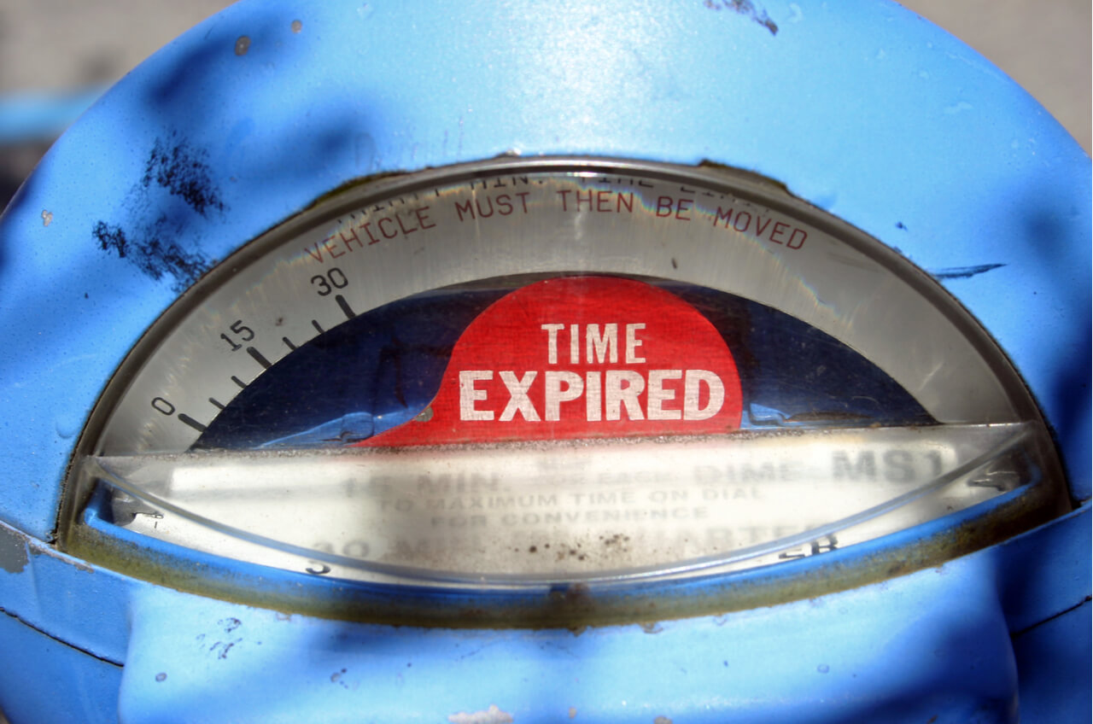
Background: Previously Available Tools
In the past, ICPI also released frozen DRTs after the data entry period closed…too late to be truly useful

Slide 8

New Tool for Your Data Quality Toolkit!
The in-process DRT extracts can now be downloaded from Genie during the data entry & cleaning periods
Allows partners & staff to quickly review data using a basic set of data quality standards

Slide 9

Benefits of using the DRT
Enhanced Workflow
Reduce time needed to identify many common issues
Can be used to identify/prioritize most critical data issues
Ability to drill down to data entry level (Site/IM level) = ability to take corrective action!
Ability to filter to relevant agency, IM, program area, or geographic area

Slide 10


The DRT is…
DRT is like a power drill….
It is fast & efficient!! But only useful for certain kinds of things
DRT is not meant to…
Be the only tool in your data quality review toolkit
Cover every aspect of data quality teams should review

Slide 11

Types of Data Quality Checks

Slide 12
Indicators Included
14 indicators are included in data quality checks
QUARTERLY | SEMI-ANNUAL | ANNUAL
HTS_TST | KP_PREV | TX_PVLS
PMTCT_ART | PP_PREV | TX_RET
PMTCT_EID | TB_ART
PMTCT_STAT | TB_STAT
PrEP_NEW
TX_CURR
TX_NEW
VMMC_CIRC

Slide 13




Types of Data Checks
Included in DRT
Not Included in DRT
Checks Across Time Periods
MER Logic Checks
Disaggregate Completeness
Contextual Site/IM Info
Consistency/
Variability of Values Over Time
Other/ Miscellaneous Checks
Programmatic Checks
For additional information about other kinds of data quality checks that are not included in the DRT, see the Data Lifecycle, Review, and Quality Plenary (PALS 2017)
Notes:
For additional information about other kinds of data quality checks that are not included in the DRT, see the Data Lifecycle, Review, and Quality Plenary (PALS 2017)

Slide 14




Types of Checks – Checks Across Time Periods
Checks Across Time Periods – assesses the consistency of reporting across time
Cases identified in these checks may not be problematic – especially if there were intentional program shifts!
Specific Checks
Site/IM had targets but did not report results
Site/IM reported results but did not have targets
Site/IM reported results last period but not this period
IM reported results at a site this period but not last period
Notes:
There could be intentional programmatic shifts to/away from sites by different IMs – in which case this is not a problem. However, these can also be indicative of data reporting issues or an area of programmatic concern.

Slide 15


Types of Checks - MER Logic Checks
MER Logic Checks – Checks relationships
a) within an indicator or
b) between two indicators
to see if logic from MER Guidance is followed
Current Checks
Numerator reported but not Denominator
Denominator reported but not Numerator
Numerator > Denominator
Notes:
MER Logic Checks are based on MER Guidance – they assess the relationships within a MER indicator or between two related MER indicators to see whether the logic from MER Guidance is violated. Some are relatively firm rules, there will very rarely be a situation in which TX_NEW is greater than TX_CURR. This is because by definition, TX_CURR is the number of people currently on treatment – this includes those who are newly enrolled on treatment this quarter (TX_NEW) and those who were enrolled on previous quarters.
Other rules may indicate data quality problems BUT there might also be reasonable programmatic explanations for why a rule was violated. Often times it may depend on a) the level that you’re doing the check at and b) the contextual situation of your program.
For example, MER guidance (and good programming) suggests that if circumcisions are being performed (VMMC_CIRC) then testing should also be offered through the VMMC service delivery modality. However, maybe you have a situation where you have two partners working in a circumcision facility – you might have one partner working on and reporting on circumcision (VMMC_CIRC) and a second partner doing the testing (HTS_TST service delivery model of VMMC). In this case, it would not be a problem at a Site x IM level if you see VMMC reported but no data in the HTS_TST VMMC modality then it wouldn’t be a problem. But if you looked at the Site level, you’d would definitely expect to see HTS_TST data in the VMMC modality if VMMC is being reported at that PSNU.

Slide 16
Types of Checks - MER Logic Checks
Current Checks Continued
TX_NEW reported but not TX_CURR
TX_CURR reported but not TX_NEW
TX_NEW > TX_CURR
VMMC_CIRC reported, but HTS_TST VMMC modality not reported
PMTCT_ART_NEW ≠ TX_NEW Pregnant Disaggregate
TB_ART_D ≠ TB_STAT_POS_N
Notes:
MER Logic Checks are based on MER Guidance – they assess the relationships within a MER indicator or between two related MER indicators to see whether the logic from MER Guidance is violated. Some are relatively firm rules, there will very rarely be a situation in which TX_NEW is greater than TX_CURR. This is because by definition, TX_CURR is the number of people currently on treatment – this includes those who are newly enrolled on treatment this quarter (TX_NEW) and those who were enrolled on previous quarters.
Other rules may indicate data quality problems BUT there might also be reasonable programmatic explanations for why a rule was violated. Often times it may depend on a) the level that you’re doing the check at and b) the contextual situation of your program.
For example, MER guidance (and good programming) suggests that if circumcisions are being performed (VMMC_CIRC) then testing should also be offered through the VMMC service delivery modality. However, maybe you have a situation where you have two partners working in a circumcision facility – you might have one partner working on and reporting on circumcision (VMMC_CIRC) and a second partner doing the testing (HTS_TST service delivery model of VMMC). In this case, it would not be a problem at a Site x IM level if you see VMMC reported but no data in the HTS_TST VMMC modality then it wouldn’t be a problem. But if you looked at the Site level, you’d would definitely expect to see HTS_TST data in the VMMC modality if VMMC is being reported at that PSNU.

Slide 17


Types of Checks – Disaggregate Completeness
Disaggregate Completeness Checks – Compares completeness of a disaggregate (e.g., age/sex) to the overall total (e.g., Total Numerator)
Disaggregate Completeness Checks will not be deployed after the Q2 initial entry period has closed
Until then, teams are encouraged to use OGAC’s DATIM completeness favorites (“PEPFAR FY18 Q2 SAPR Completeness Review Pivot”)

Slide 18
Types of Checks – Disaggregate Completeness
Disaggregate Completeness Checks – Compares completeness of a disaggregate (e.g., age/sex) to the overall total (e.g., Total Numerator)
Initial focus of DRT
PMTCT_STAT with more coming soon!
NOT IN DRT
Disagg
Disagg
Disagg
Notes:
The majority of Disaggregate Completeness Checks that will be deployed in Q2 will be focused on identifying cases where the sum of disaggregates are greater than the total numerator (or where the total numerator is missing completely). However, there are flags related to PMTCT_STAT that highlight any cases where the sum of the disaggregates do not exactly equal the total numerator. Additional disaggregate completeness checks that assess exact completeness are in the process of being developed. The DRT does not include checks that assess under-completeness (when the total sum of the disaggregates are less than the total numerator)

Slide 19



Types of Checks – Contextual Site/IM Info
Contextual Site/IM Info – These do not suggest a data quality violation
They provide context by showing:
Total # of Site/IMs reporting results for an indicator
Total # of Site/IMs reporting targets for an indicator
Total # of Site/IMs reporting results AND targets
Prioritize data cleaning efforts by comparing values from the Contextual Site/IM section to values of data quality checks to see if violations represent large or small proportion of the overall data

Slide 20

What Does it Mean When a Check is “Violated”?
When a check appears in the tool it does not necessarily mean data is bad/needs to be fixed
Sometimes “violations” can be explained by legitimate programmatic reasons
Ex. intentional programmatic shifts explain why an IM reported results at a site in Q1 but not in Q2
Staff and partners must use their knowledge of their program to determine where there are problems & to prioritize what data needs to be changed!
Notes:
The checks do not necessarily mean that the data is incorrect or wrong or unexpected. For example, there may be programmatic reasons & shifts that can explain why a site/IM had a target but doesn’t have results. But there are some other types of checks are more likely to be indicative of a data quality issue – for example a numerator that is greater than your denominator.

Slide 21

Accessing the DRT in genie

Slide 22
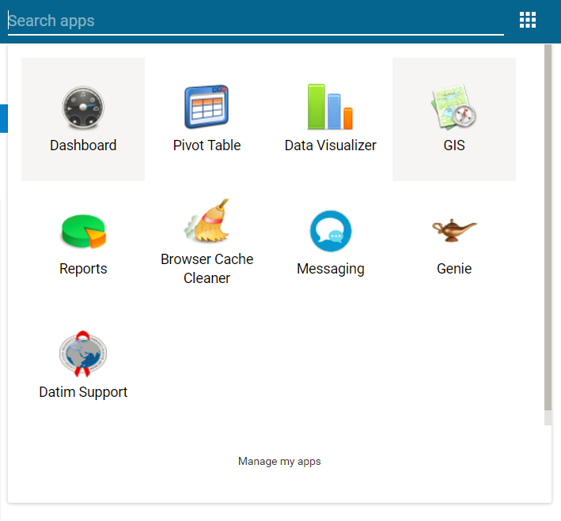
Step 1 – Genie DRT Extract
Log in to DATIM.org and go to the Genie app

Slide 23
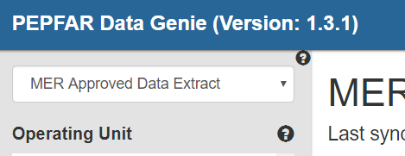
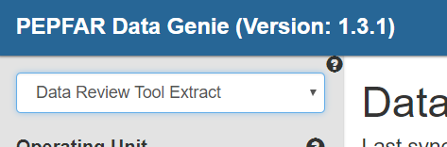
Step 2 – Genie DRT Extract
Select “Data Review Tool Extract” in the drop down at the top left of screen:

Slide 24
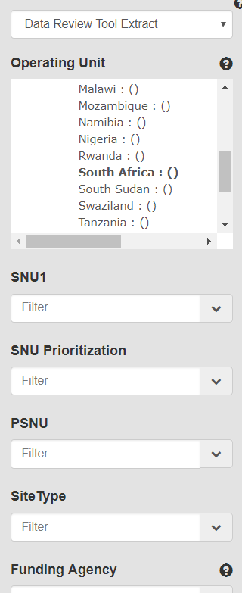
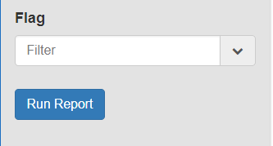
Step 3 – Genie DRT Extract
REQUIRED: Select one OU
OPTIONAL: Select additional parameters through the filters
Click on “run report” button at bottom of menu when ready

Slide 25
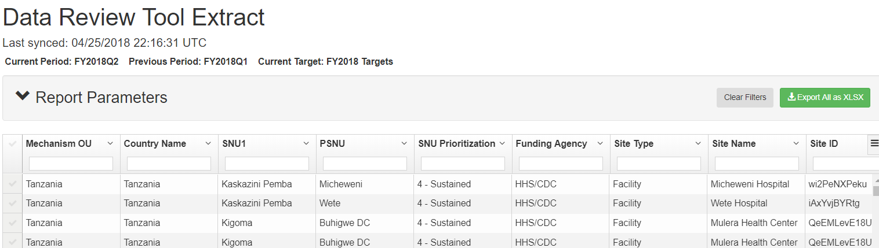
Step 4 – Genie DRT Extract
Once report finishes running, click on “Export All as .XLSX” at top right of page
Expand the “Report Parameters” section to review what filters were applied

Slide 26
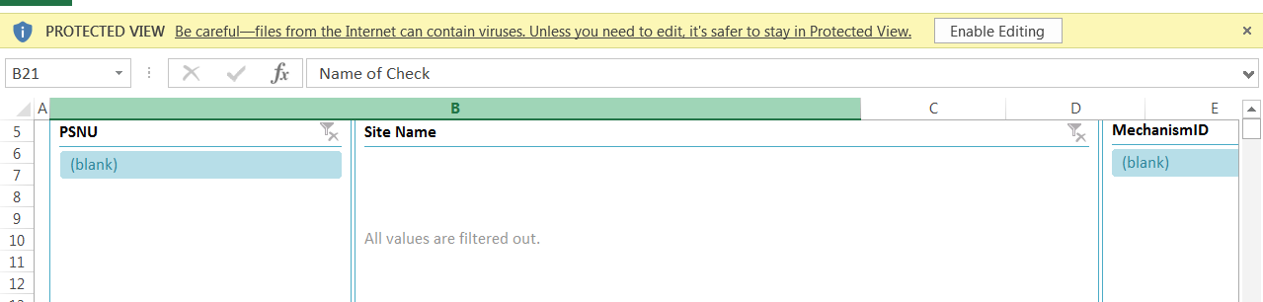
Step 5 – Genie DRT Extract
The DRT will be download to your computer in a zip file. Locate the download & extract/unzip the file.
When you open the unzipped file, Excel will try to open the file in “protected mode”
You must click the “Enable Editing” button to view the data in your DRT!

Slide 27

data availability
Account Permissions Levels, Security, and Timing

Slide 28
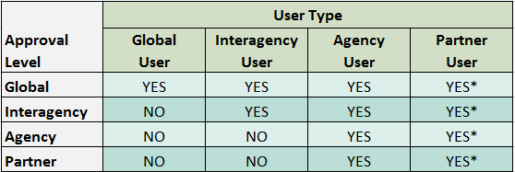
DATIM User Approval Level
Different user accounts will have access to different data depending on their account privileges
As a rule, if an account can not see certain data in DATIM Pivot Tables, it will not be able to see that data in the DRT
*Partner level users can only view their own data. Regardless of approval level, users with partner level accounts can not view data from other implementing partners.

Slide 29
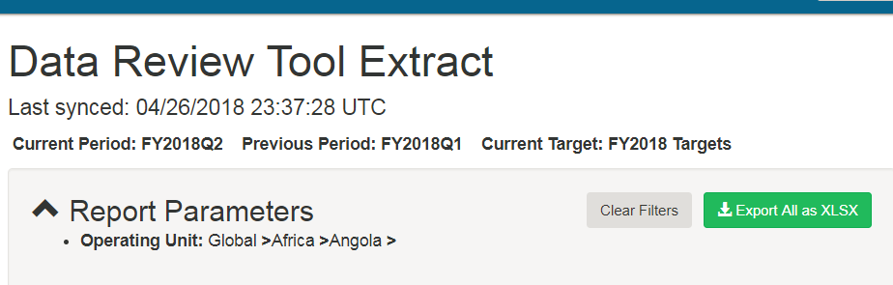
Availability/Timing of Data in the DRT
There is a delay before data entered into DATIM appears in the DRT extract
DATIM data is synced to the DRT in Genie once a day. The Genie displays the time and date of the last sync. Only data entered befre the date stamp will appear in the DRT extract.
datim.org sync to DATIM Data Genie | Time Zone | Start of Sync | Data Available in DRT
 | US Eastern Time | 12:00PM | 7:30AM Next Day
 | Bangkok, Thailand | 11:00PM | 6:30PM Next Day
 | Johannesburg, South Africa | 6:00PM | 1:30PM Next Day

Slide 30

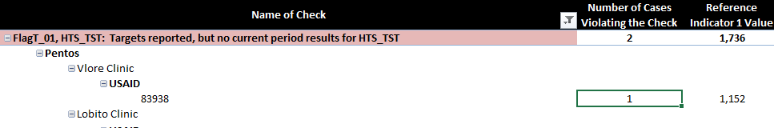
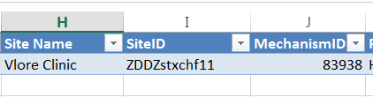
Sensitive Site Names
Sensitive site names are masked for security purposes
If a site contains sensitive words/phrases like “battalion”, “narcology”, “sex worker” then the facility name replaced with an anonymized name
If needed, the original site name can be looked up by using the Site ID
Double click on the pivot table (as shown below) and a new tab will appear with raw data that lists the Site ID
Notes:
The site name associated with each SiteID can be looked up on DATIM’s zendesk in the Org Unit Code List (https://datim.zendesk.com/hc/en-us/articles/115002334246-DATIM-Data-Import-and-Exchange-Resources)

Slide 31

Exploring the drt’s structure

Slide 32

User Guide & Appendix
User’s Guide Tab
Provides info about how to use the tool, key updates & other critical info
Data Checks Appendix Tab
A complete list of all data quality checks that were performed (regardless of whether or not a check was violated)
Contains longer descriptions explaining each data quality flag

Slide 33
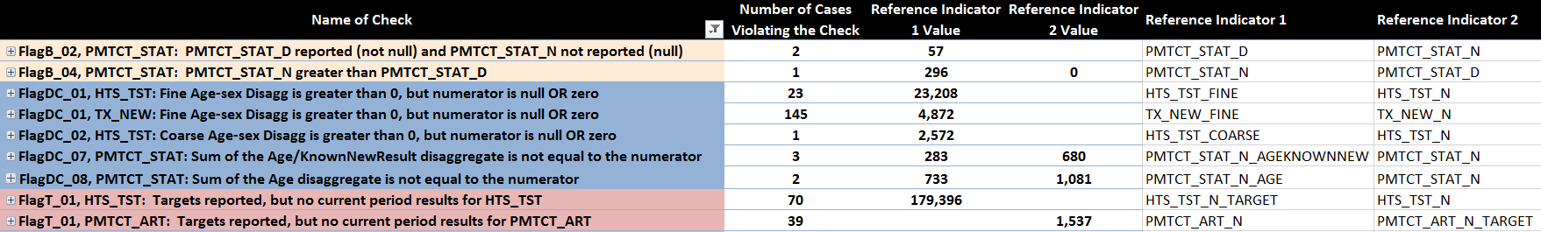
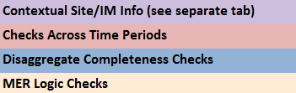
Exploring the DRT – Main Site x IM Tab
Data quality checks laid out in an expandable table
What quality check was violated (color-coded according to type)
Only data checks that were violated appear in the Site x IM tab

Slide 34
Exploring the DRT – Main Site x IM Tab
How many Site/IM combinations violated a check

Slide 35
Exploring the DRT – Main Site x IM Tab
The total values of indicators at the Site/IMs that violated each check

Slide 36
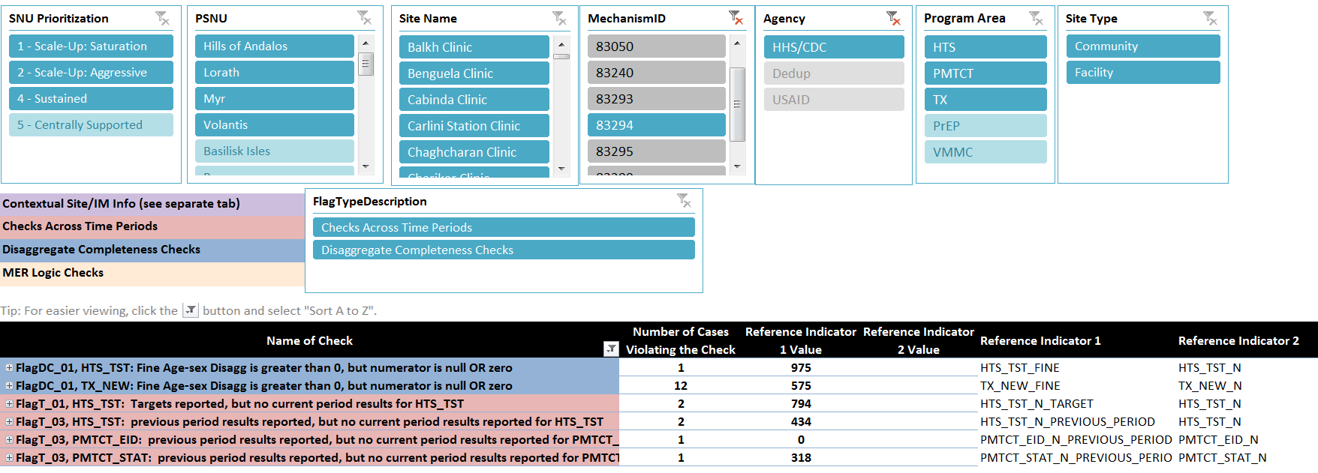
Exploring the DRT – Main Site x IM Tab
Use slicers (filter buttons) to look only at particular geographies, IMs, agencies, program areas, or types of data quality checks

Slide 37
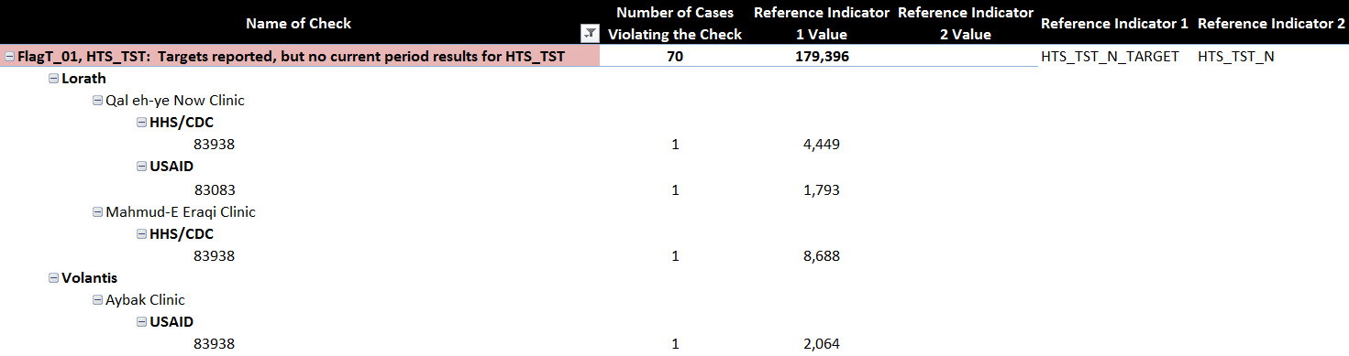
Exploring the DRT – Main Site x IM Tab
Use the +/- buttons to expand/collapse the table
Allows you to view the particular Site/IMs that violated each flag
PSNU
Site Name
Agency
IM

Slide 38
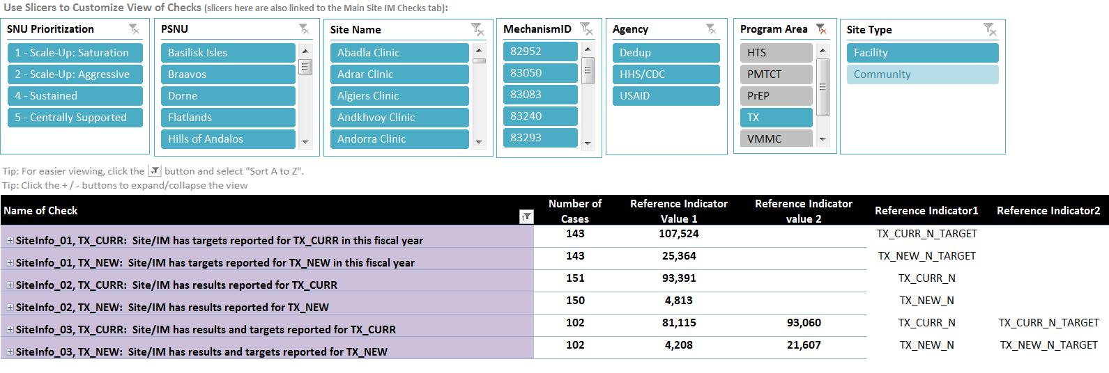
Exploring the DRT – Contextual Site x IM Info Tab
Same layout as Main Site x IM Checks tab. But only contains Contextual Site Info checks.
This tab is especially useful during data entry when not all site/IMs will have entered results – provides a way to track data entry progress

Slide 39
Additional Resources
Resource | Description
Data Lifecycle, Review, and Quality Plenary (PALS 2017) | Provides an overview of: The PEPFAR Data Lifecycle Types of Data Checks (with examples) Tools for Reviewing Data Quality Developing Processes Around Data Checks
Monitoring, Evaluation, and Reporting (MER 2.0) Indicator Reference Guide (version 2.2) | Provides definitions of MER indicators Gives guidance on how to review data quality for each indicator
DATIM Support | Find additional guidance, tutorials, and technical support (including helpdesk ticket submission)
OGAC created DATIM favorites | OGAC has a list of curated DATIM Favorites focused on Disaggregate Completeness Checks. Search “PEPFAR FY18 Q” in DATIM Favorites for a list of pivot tables for this quarter

